Slide 1

Natural Language Processing
Rohit Kate
Transformers – Part 2

Slide 2
Reading
Sections 8.3 & 8.4 (skip the code), Textbook 1

Slide 3
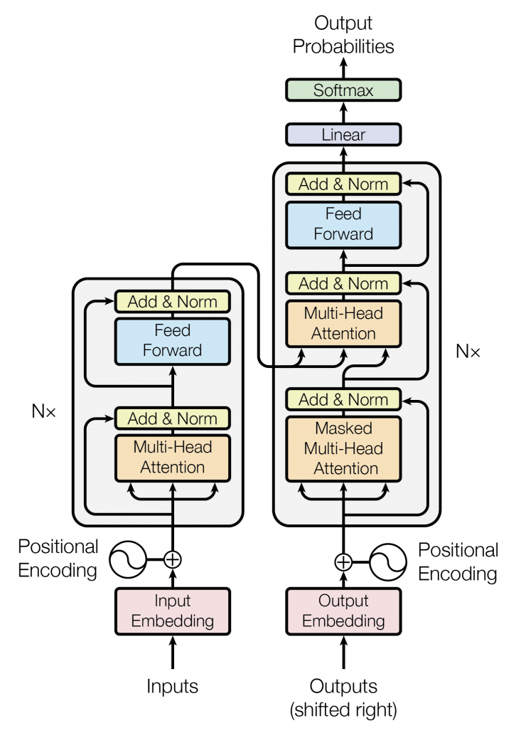
Big Picture
Encoder-Decoder
attention
Multiple layers inside decoder
Multiple layers
inside encoder
Self-attention
Self-attention
Figure 1 from the paper.

Slide 4
Add and Norm Component
Residual
connection

Slide 5
Add and Norm Component
The input is added to the output of the multi-head attention
Called residual or skip connection
This has been found to help
The result is then normalized (to have mean 0 and standard deviation 1)
This is known to result in faster training

Slide 6
Feed-Forward Networks

Slide 7
Feed-Forward Networks
After attention sub-layer, a fully-connected feed-forward network is added
Gives opportunity for more learning
It is applied to each word position separately and identically
Same weights are shared
This is passed through another Add and Norm component

Slide 8
Encoders
This forms one encoder;
then this is repeated N times.

Slide 9
Encoders
New representation
Encoder 4
Encoder 3
Encoder 2
Encoder 1
green
small
tree

Slide 10
Encoders
Will these representations be the same or different?
Should they be so?
New
representation
New
representation
Encoder 4
Encoder 4
Encoder 3
Encoder 3
Encoder 2
Encoder 2
Encoder 1
Encoder 1
dog
bit
man
man
bit
dog

Slide 11
Attention Mechanism and Word Order
The attention mechanism, although superior to sequential processing, completely ignores the word order!
bit’ = dog_{v}*f(bit_{q},dog_{k}) + bit_{v}*f(bit_{q},bit_{k}) +man_{v}*f(bit_{q},man_{k})
In contrast, RNN used to keep the word order due to sequential processing
Word order is important in NLP

Slide 12
Positional Encoding

Slide 13
Positional Encoding
Because words are not given in a sequence as in RNN, the model seen so far loses the order of words
There needs to be a way to encode the positional information of words
which were the first word, second word, etc.
There could be multiple ways to do that
Simply adding or concatenating the word position (1, 2, etc.) to the word embedding does not work well
For example, very little difference between “dog” in the first position and “dog” in 2nd or 3rd position

Slide 14
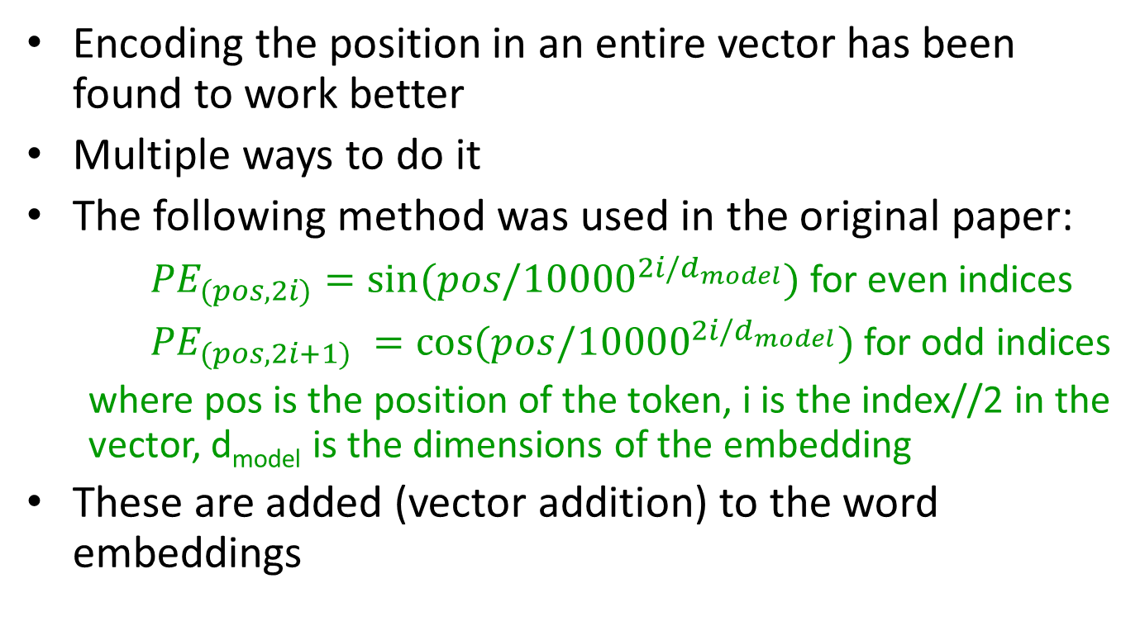
Positional Encoding
Encoding the position in an entire vector has been found to work better
Multiple ways to do it
The following method was used in the original paper:
${PE}_{(pos,2i)}=sin⁡(pos/{10000}^{2i/d_{model}})$ for even indices
${PE}_{(pos,2i+1)} =cos⁡(pos/{10000}^{2i/d_{model}})$ for odd indices
where pos is the position of the token, i is the index//2 in the vector, d_{model} is the dimensions of the embedding
These are added (vector addition) to the word embeddings

Slide 15
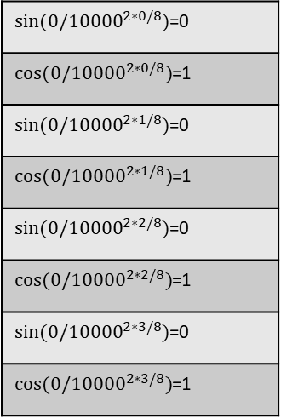
Positional Encoding
man bit dog
pos=0
i=0
$sin⁡(0/{10000}^{2∗0/8})$=0
$cos(0/{10000}^{2∗0/8})$=1
$sin⁡(0/{10000}^{2∗1/8})$=0
$cos(0/{10000}^{2∗1/8})$=1
$sin⁡(0/{10000}^{2∗2/8})$=0
$cos(0/{10000}^{2∗2/8})$=1
$sin⁡(0/{10000}^{2∗3/8})$=0
$cos(0/{10000}^{2∗3/8})$=1
i=0
i=1
i=1
d_{model}=8
i=2
i=2
i=3
i=3

Slide 16
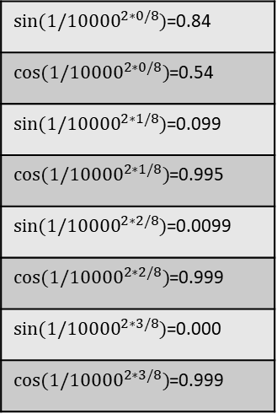
Positional Encoding
man bit dog
pos=0
pos=1
0
1
0
1
0
1
0
1
i=0
$sin⁡(1/{10000}^{2∗0/8})$=0.84
$cos(1/{10000}^{2∗0/8})$=0.54
$sin⁡(1/{10000}^{2∗1/8})$=0.099
$cos(1/{10000}^{2∗1/8})$=0.995
$sin⁡(1/{10000}^{2∗2/8})$=0.0099
$cos(1/{10000}^{2∗2/8})$=0.999
$sin⁡(1/{10000}^{2∗3/8})$=0.000
$cos(1/{10000}^{2∗3/8})$=0.999
i=0
i=1
i=1
d_{model}=8
i=2
i=2
i=3
i=3

Slide 17
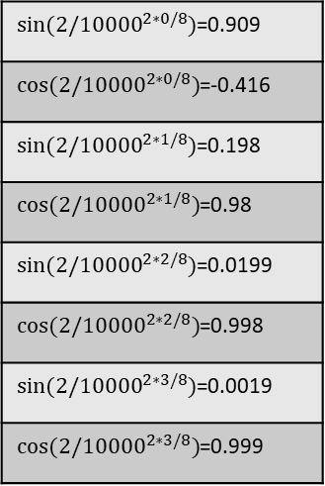
Positional Encoding
man bit dog
pos=0
pos=1
pos=2
0
1
0
1
0
1
0
1
0.84
0.54
0.099
0.995
0.0099
0.999
0.000
0.999
i=0
$sin⁡(2/{10000}^{2∗0/8})$=0.909
$cos(2/{10000}^{2∗0/8})$=-0.416
$sin⁡(2/{10000}^{2∗1/8})$=0.198
$cos(2/{10000}^{2∗1/8})$=0.98
$sin⁡(2/{10000}^{2∗2/8})$=0.0199
$cos(2/{10000}^{2∗2/8})$=0.998
$sin⁡(2/{10000}^{2∗3/8})$=0.0019
$cos(2/{10000}^{2∗3/8})$=0.999
i=0
i=1
i=1
d_{model}=8
i=2
i=2
i=3
i=3

Slide 18
Positional Encoding
man bit dog
pos=0
pos=1
pos=2
0
1
0
1
0
1
0
1
0.84
0.54
0.099
0.995
0.0099
0.999
0.000
0.999
0.909
-0.416
0.198
0.98
0.0199
0.998
0.0019
0.999
These will be added (vector addition) to the word embeddings of the words.

Slide 19
Positional Encoding
pos=0
man
pos=1
bit
pos=2
dog
0
1
0
1
0
1
0
1
0.84
0.54
0.099
0.995
0.0099
0.999
0.000
0.999
0.909
-0.416
0.198
0.98
0.0199
0.998
0.0019
0.999
+
+
+
These will be added (vector addition) to the word embeddings of the words.

Slide 20
Positional Encoding
pos=0
dog
pos=1
bit
pos=2
man
0
1
0
1
0
1
0
1
0.84
0.54
0.099
0.995
0.0099
0.999
0.000
0.999
0.909
-0.416
0.198
0.98
0.0199
0.998
0.0019
0.999
+
+
+
Now dog in the 1st position will be different from dog in the 3rd position.

Slide 21
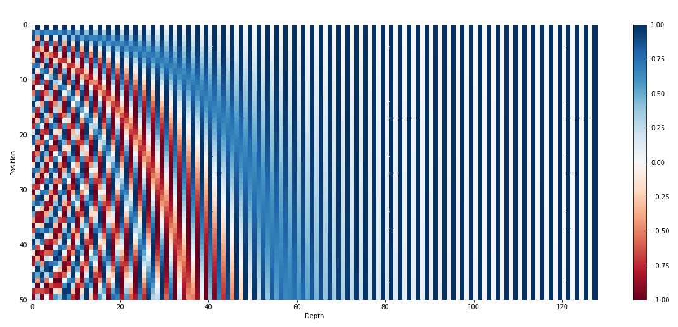
Positional Encoding
Word 0
Word 1
Word 50
d_{model}=128
Image source: https://kazemnejad.com/blog/transformer_architecture_positional_encoding/

Slide 22
Positional Encoding
Decoder also has positional encoding
Positional Encoding

Slide 23
Encoder-Decoder Attention
Encoder-decoder attention

Slide 24
Encoder-Decoder Attention
The new representations from encoder are used as keys and values for each query from the decoder layer to get its new representation (in the context of the input words)
Also called cross-attention
Queries come from the previous decoder layer and the keys and values come from the last encoder
Example: How does “arbolito” relate to the input words
Helps find relation between words of the source and target languages

Slide 25
Encoder-Decoder
arbolito
Encoder 4
Decoder 4
Encoder 3
Decoder 3
Encoder 2
Decoder 2
Encoder 1
Decoder 1
green small tree
<start>

Slide 26
Encoder-Decoder
verde
Encoder 4
Decoder 4
Encoder 3
Decoder 3
Encoder 2
Decoder 2
Encoder 1
Decoder 1
green small tree
<start> arbolito
Not showing self-attention within decoder

Slide 27
Encoder-Decoder
<end>
Encoder 4
Decoder 4
Encoder 3
Decoder 3
Encoder 2
Decoder 2
Encoder 1
Decoder 1
green small tree
<start> arbolito verde
Not showing self-attention within decoder

Slide 28
Attention in Decoder
Self-attention

Slide 29
Self-Attention in Decoder
Self-attention: Attend to all positions of the decoder up to and including the current position
But need to prevent leftward information flow
Mask out (setting to minus infinity) all illegal connections

Slide 30
Self-Attention
<start>
arbolito
verde

Slide 31
Self-Attention
<start>
arbolito
verde

Slide 32
Self-Attention
<start>
arbolito
verde

Slide 33
Add & Norm and Feed Forward
These layers are also present in the decoder.

Slide 34
Decoders
This forms one decoder;
then this is repeated N times.

Slide 35
Linear and Softmax Layers

Slide 36
Linear and Softmax Layers
The last decoder’s output is used to predict the next word probability
The output of the last decoder is given to a linear layer (weights without activation)
It generates a vector equal to the size of the target vocabulary
It is passed through softmax layer to generate probability of every word

Slide 37
Linear and Softmax Layers
... verde:0.9 azul: 0.05 numero: 0.01 …
Softmax
Linear
Encoder 4
Decoder 4
Encoder 3
Decoder 3
Encoder 2
Decoder 2
Encoder 1
Decoder 1
green small tree
<start> arbolito

Slide 38
Training
For machine translation task, it will be trained on a parallel corpus of pairs of sentences in the source and target languages
In the original paper
4.5 million English-German sentence pairs for English to German translation
36 million English-French sentence pairs for English to French translation
All the Ws are the weights to be learned
Cross-entropy loss is used
Classification task: All words of the target language as classes

Slide 39
Transformer-Based Language Model
Although designed as a sequence-to-sequence model, transformer architecture can also be used as a language model
Do not have the encoder!
Similar to RNN-based language model, do sampling to generate the output word, feed it back
Unconditional generation

Slide 40
Transformer-Based Language Model

Slide 41
GPT
Generative pre-trained transformer (GPT)
Series of language models using the transformer architecture developed by OpenAI
GPT-2 is publicly available as a model
GPT-3 onwards are only available for use through their API; used in ChatGPT

Slide 42
GPT-2
Very large language model
Uses 48 layers
Trained on a huge amount of text from the web
Available through hugging-face
https://huggingface.co/gpt2

